Slide 1

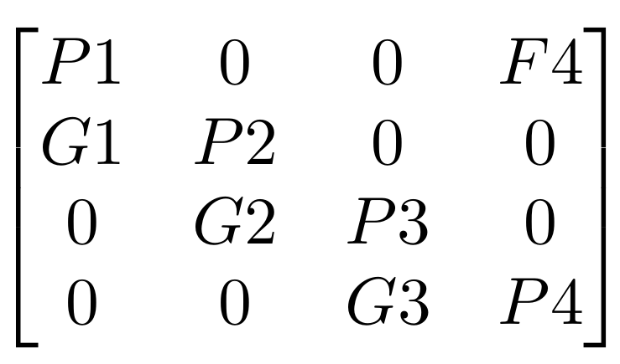
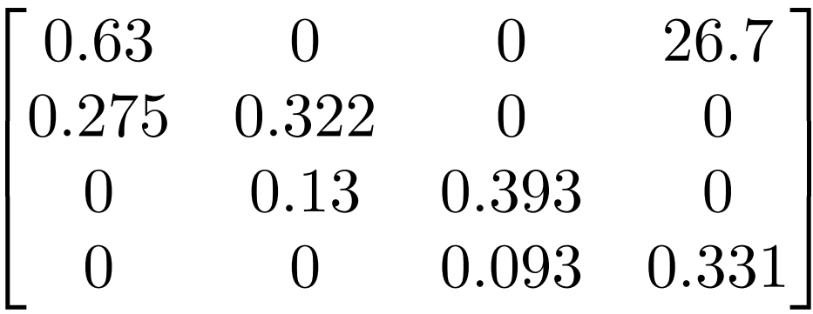
a)
F₄
Stage 1
G₁
Stage 2
G₂
Stage 3
G₃
Stage 4
P₁
P₂
P₃
P₄
b)
c)

